Slide 1

detection BOt for Cheque
Alice Zhang
Dec 7, 2022

Slide 2
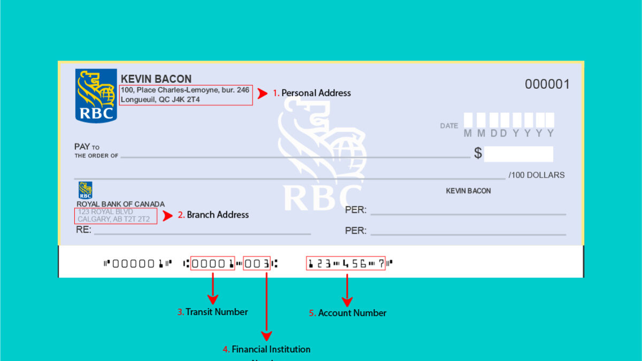
Cheque Sample

Slide 3

Persona
Peter is a self-employed Fintech professional. He receives a cheque from Company A for his exceptional data analysis rendered on the 29th of every month. He decides to purchase a vacation package for his family which will need to be paid in full on the 30th of this month to get a 15% discount. He got the cheque in the office on the 29th and took a picture of the cheque with Bank's mobile app.
Do you think he will be able to get the 15% discount?
Peter

Slide 4
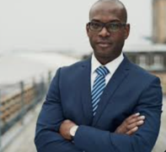
Persona
Kevin is Bank C's fraud prevention manager. He's concerned one startup company reported fraud cheques named to be from the company being electronic deposited. The owner is very upset that his months' efforts might go to vain.
Will Kevin's department had seen this coming? Will the bank end up paying all the loss?
Kevin

Slide 5
Objective of this project
The objective of the Fraud Detecting Bot is retrieving the information on the cheques and cash the cheque right away upon the information is verified.
Cheque image captured
OCR retrieve information
Identify the bank logo
Identify the MICR line pattern
Combine information from bank logo and MICR pattern
Validating info with positive pay file
Cashed

Slide 6
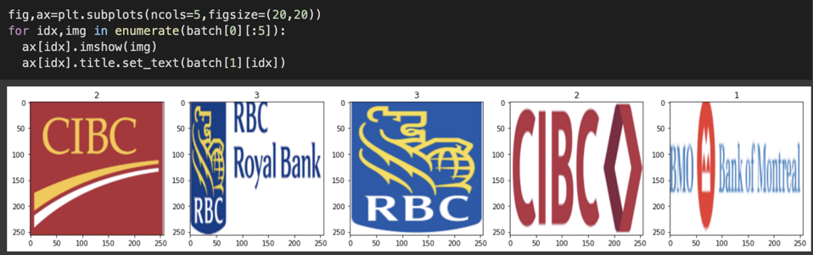
Training of Bank Logo
Dependencies were used: Tensorflow; OpenCV, etc.
Step 1, getting the data
Step 2, scaling the images

Slide 7
Training of Bank Logo
Dependencies were used: Tensorflow; OpenCV, etc.
Step 3, Create the Convolutiontional base
Step 4, Convo2D and Maxpooling2D
Step 5, 2D to 3D to vector
Step 6, Train and get to accuracy

Slide 8
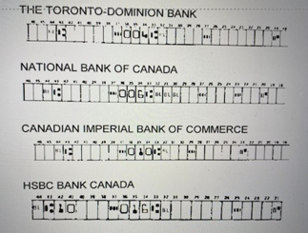
MICR Line Pattern

Slide 9
Future
Document validation
Open Banking

